Slide 1
Math 769: Statistical Learning

Slide 2
Kernel Smoothers and k-Nearest Neighbors
Shahrzad Jamshidi, PhD

Slide 3
Last Time
Regularization problems give rise to solutions based on kernel functions.
Reproducing kernel Hilbert spaces (RKHS) are spaces defined by these kernel functions.
This allows for us to embed our problem in a higher dimensional feature space without having to define these features.

Slide 4
Objectives
Define a kernel smoothing method.
Describe the k-Nearest Neighbors model.
Explain why kNN is not a kernel smoothing method.
Describe the general setup for a kernel smoothing method.

Slide 5
Kernels as Localizers
Another type of kernel method that is distinct from what we’ve previously seen is called a kernel smoothing method.
These are kernel functions specifically for localizing data—rather than focusing on the entire training set, we only consider a subset of nearby points.

Slide 6
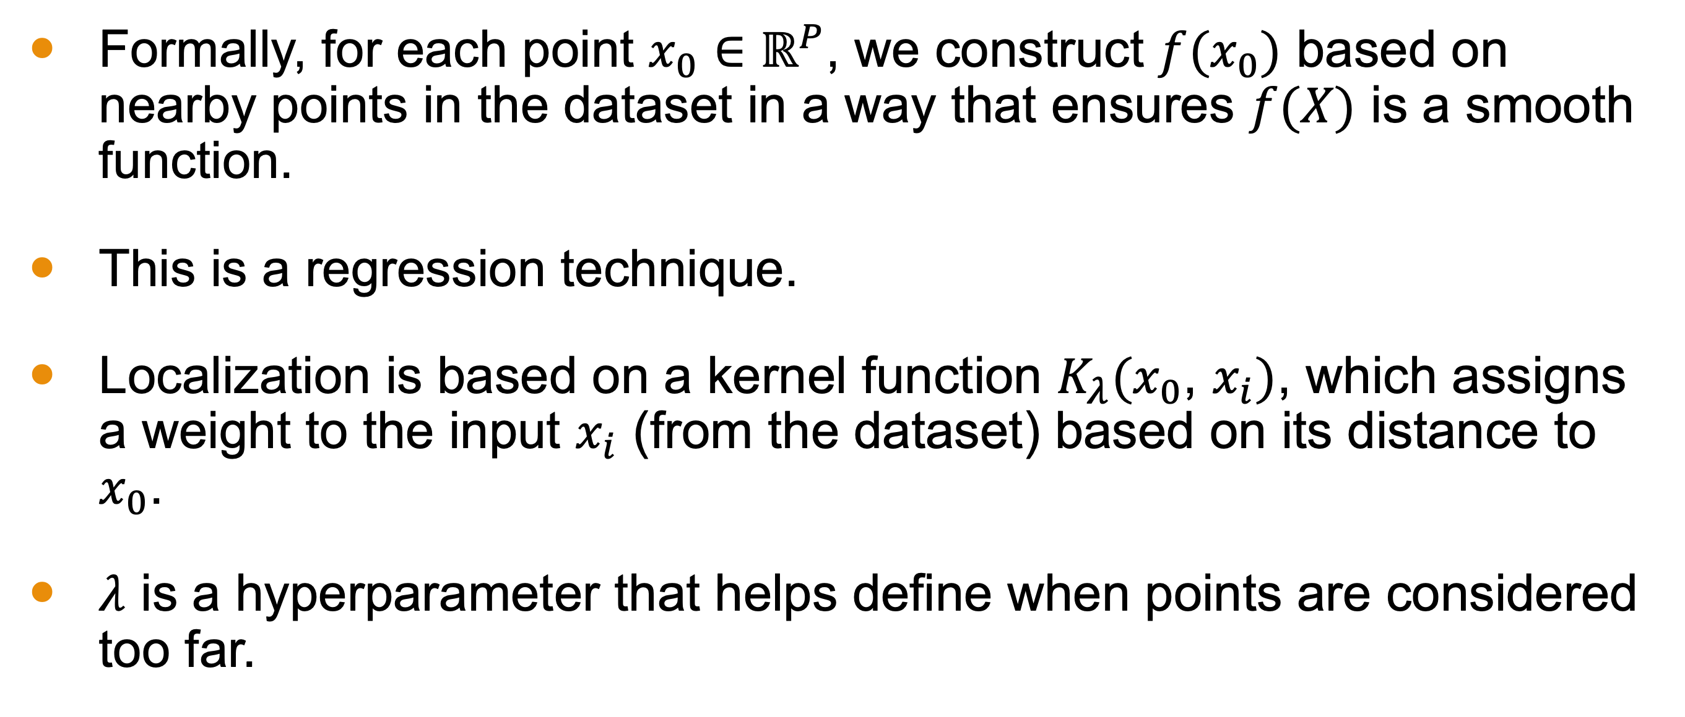
Kernel Smoothing Methods
Formally, for each point $x_{0}∈ℝ^{P}$, we construct $f(x_{0})$ based on nearby points in the dataset in a way that ensures $f(X)$ is a smooth function.
This is a regression technique.
Localization is based on a kernel function $K_{λ}(x_{0}$, $x_{i})$, which assigns a weight to the input $x_{i}$ (from the dataset) based on its distance to $x_{0}$.
$λ$ is a hyperparameter that helps define when points are considered too far.

Slide 7
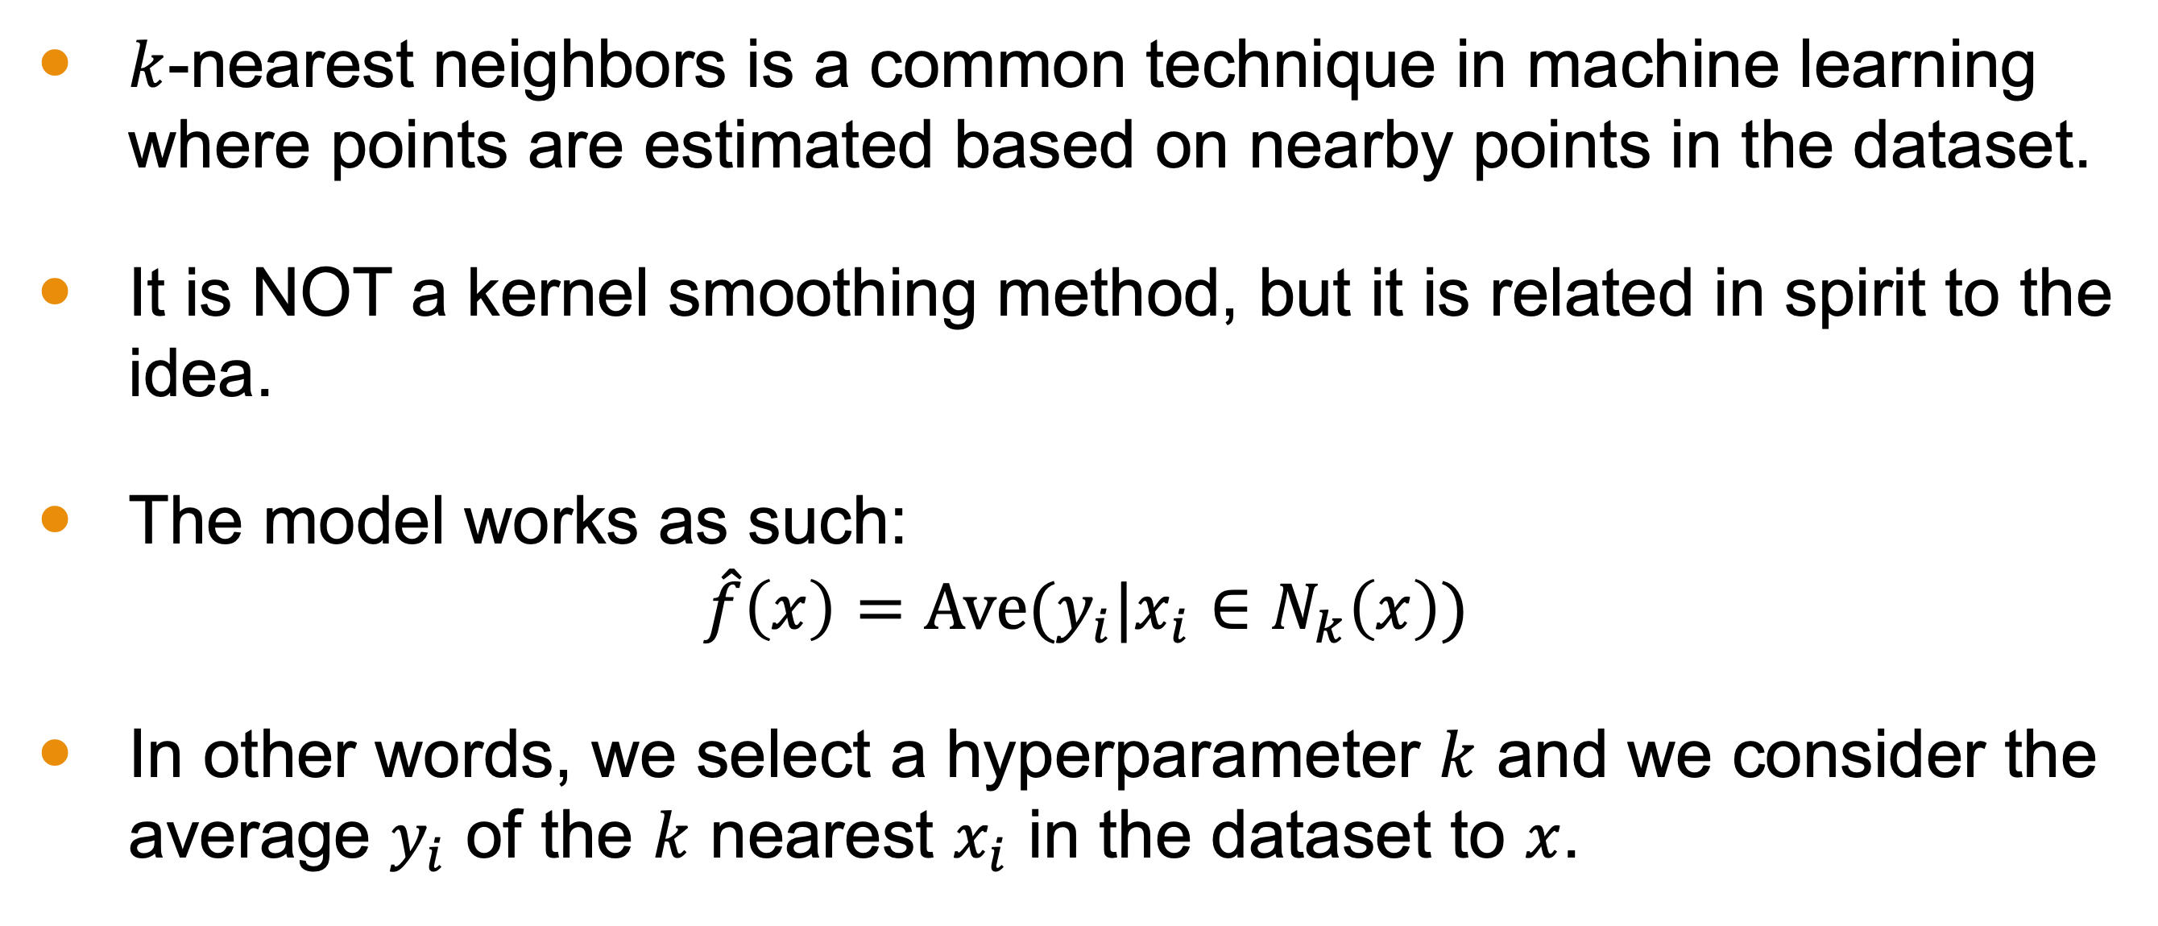

$k$-Nearest Neighbors
$k$-nearest neighbors is a common technique in machine learning where points are estimated based on nearby points in the dataset.
It is NOT a kernel smoothing method, but it is related in spirit to the idea.
The model works as such:
$$\hat{f}\left(x\right)=\text{Ave}(y_{i}|x_{i}∈N_{k}\left(x\right))$$
In other words, we select a hyperparameter $k$ and we consider the average $y_{i}$ of the $k$ nearest $x_{i}$ in the dataset to $x$.

Slide 8
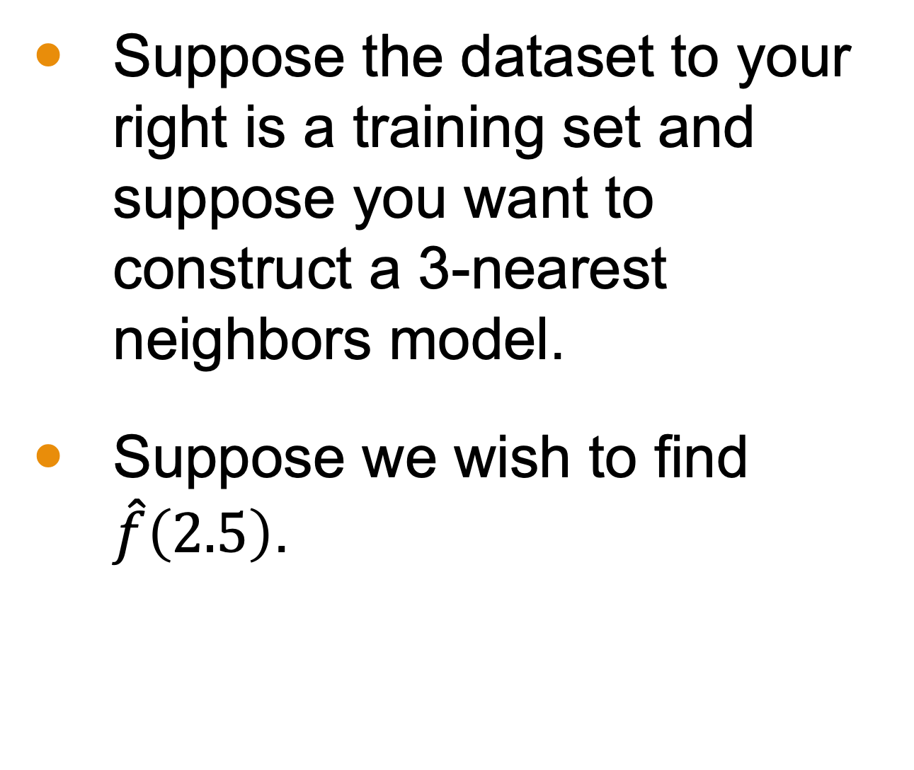
$k$-Nearest Neighbors
Suppose the dataset to your right is a training set and suppose you want to construct a 3-nearest neighbors model.
Suppose we wish to find $\hat{f}\left(2.5\right)$.
x | y
1.1 | 3.5
2.2 | 1.5
3.3 | 2.3
4.4 | 9.7
5.5 | 4.2
6.6 | 3.3
7.7 | 5.4
8.8 | 4.3

Slide 9
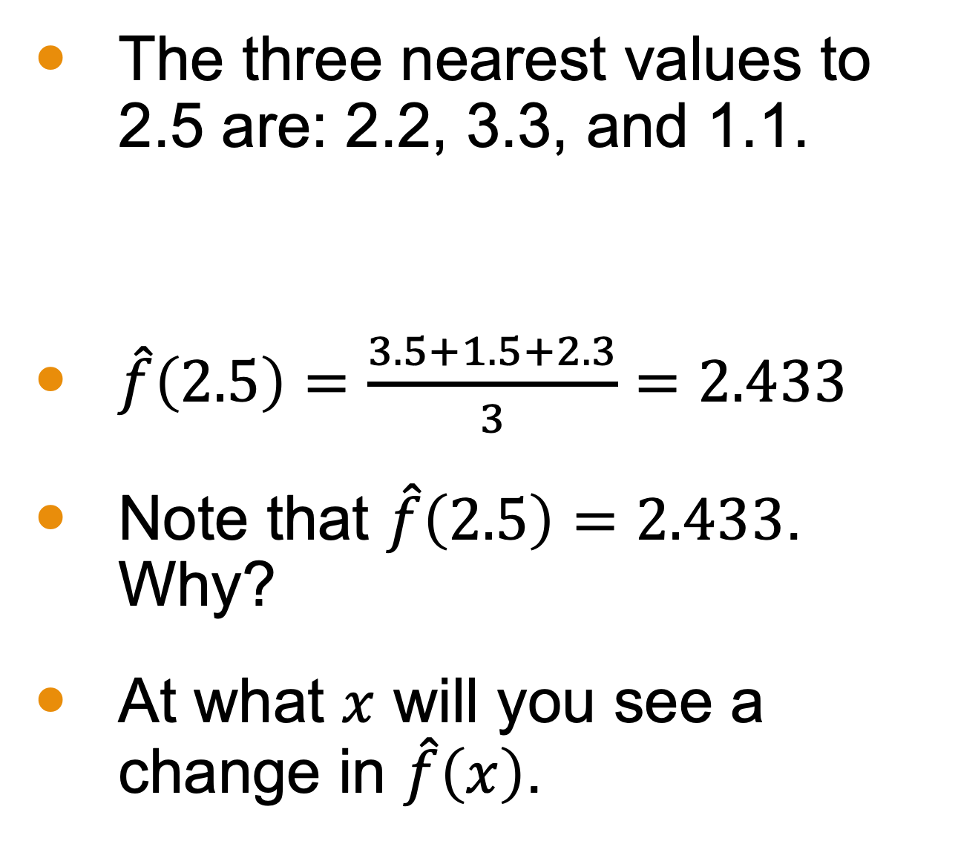
$k$-Nearest Neighbors
The three nearest values to 2.5 are: 2.2, 3.3, and 1.1.
$\hat{f}\left(2.5\right)=\frac{3.5+1.5+2.3}{3}=2.433$
Note that $\hat{f}\left(2.5\right)=2.433$. Why?
At what $x$ will you see a change in $\hat{f}\left(x\right)$.
x | y
1.1 | 3.5
2.2 | 1.5
3.3 | 2.3
4.4 | 9.7
5.5 | 4.2
6.6 | 3.3
7.7 | 5.4
8.8 | 4.3

Slide 10
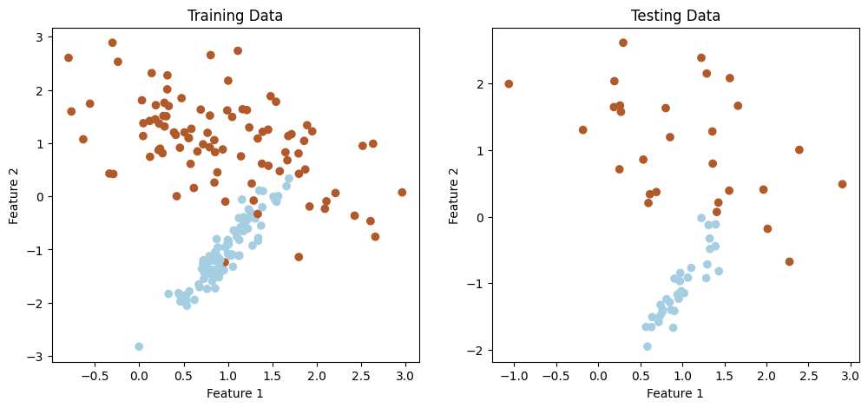
$k$-Nearest Neighbors
kNN can be used for classification as well, using ordinal encoding and rounding.
Suppose we have two classes. Below is the training and testing set.

Slide 11
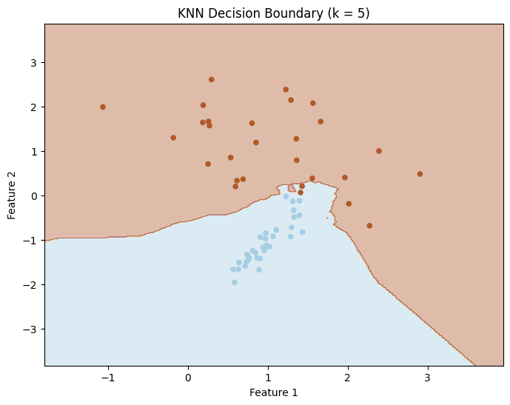
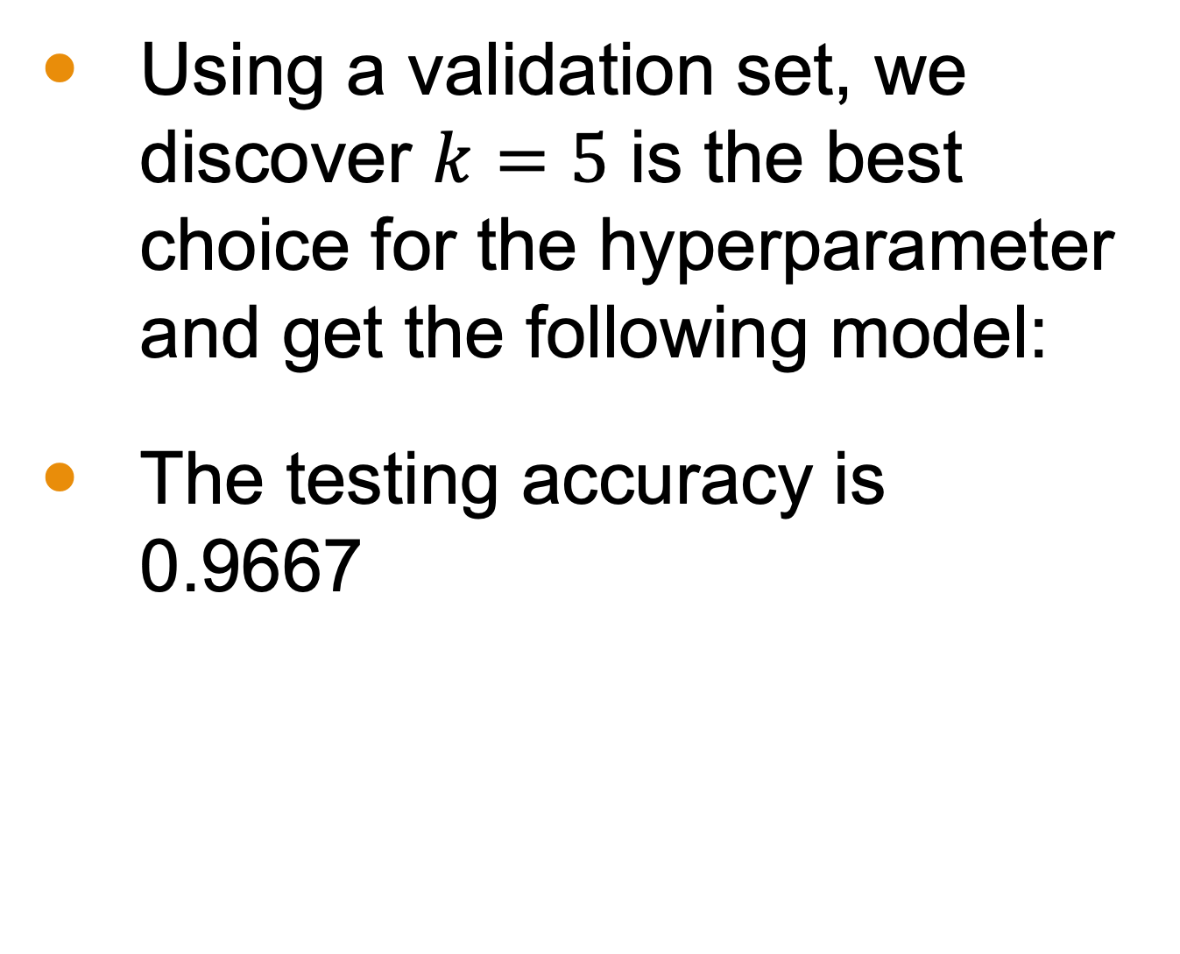
$k$-Nearest Neighbors
Using a validation set, we discover $k=5$ is the best choice for the hyperparameter and get the following model:
The testing accuracy is 0.9667

Slide 12
Why isn’t kNN a kernel smoothing method?
Notes:
This is where the linear algebra comes in

Slide 13
kNN versus Kernel Smoothing Methods
Although BOTH are localized methods, kNN does not produce a smooth function.
We can see that within the first examples—estimated output values can jump wildly.

Slide 14
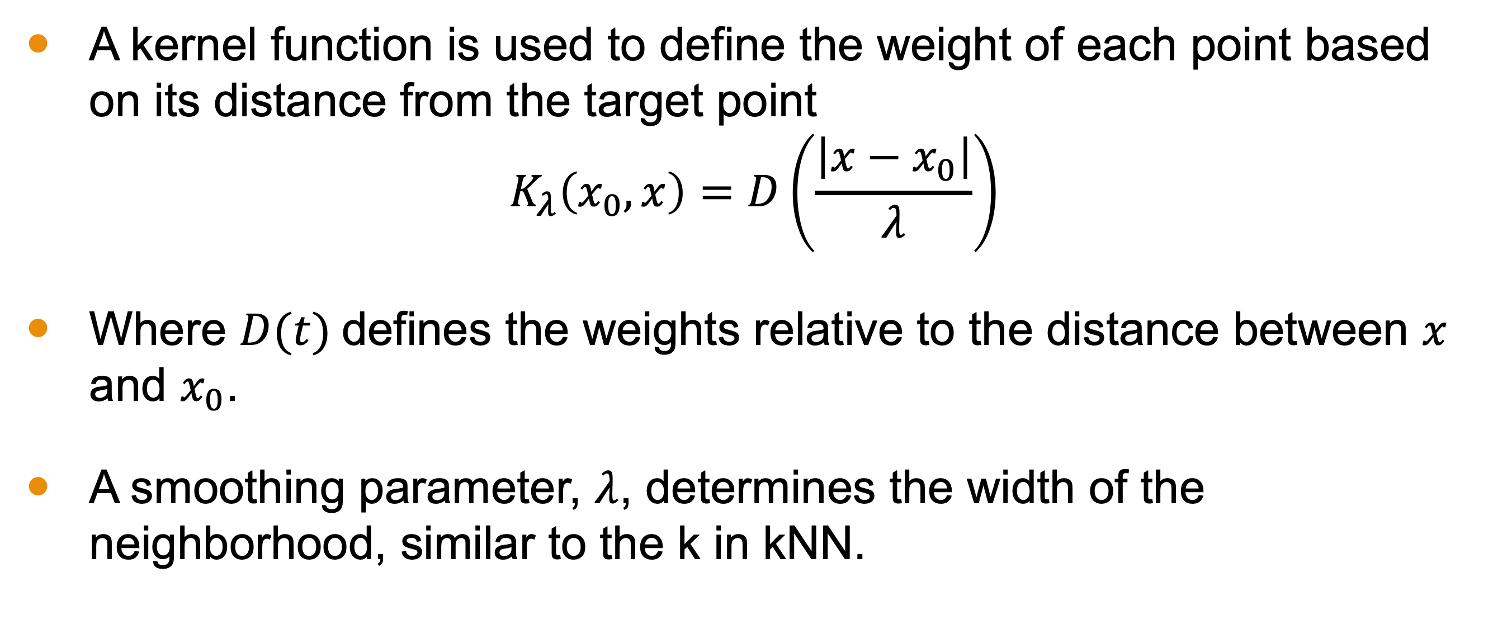
What is an Example of a Kernel Smoother?
A kernel function is used to define the weight of each point based on its distance from the target point
$$K_{λ}\left(x_{0}, x\right)=D\left(\frac{\left|x−x_{0}\right|}{λ}\right)$$
Where $D(t)$defines the weights relative to the distance between $x$ and $x_{0}$.
A smoothing parameter, $λ$, determines the width of the neighborhood, similar to the k in kNN.

Slide 15
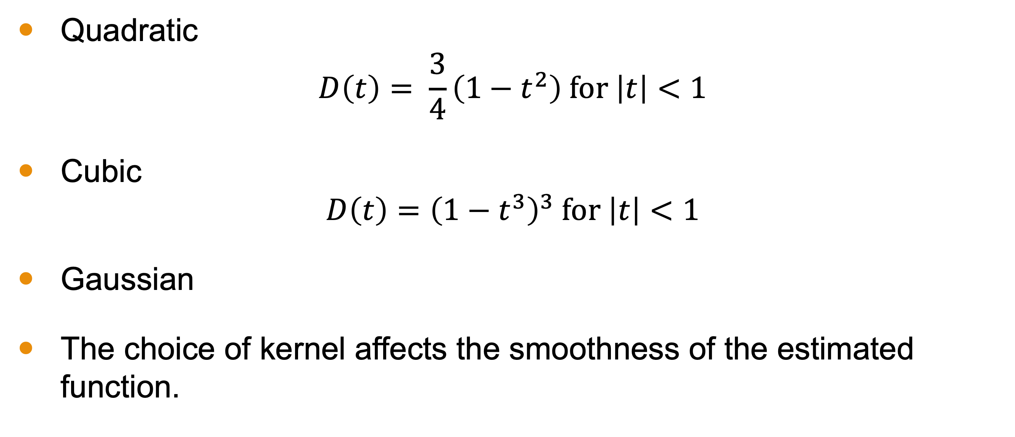

Choices for $D(t)$
Quadratic
$$D\left(t\right)= \frac{3}{4}\left(1−t^{2}\right) \text{for} \left|t\right|<1$$
Cubic
$$D\left(t\right)={\left(1−t^{3}\right)}^{3} \text{for} \left|t\right|<1$$
Gaussian
The choice of kernel affects the smoothness of the estimated function.

Slide 16
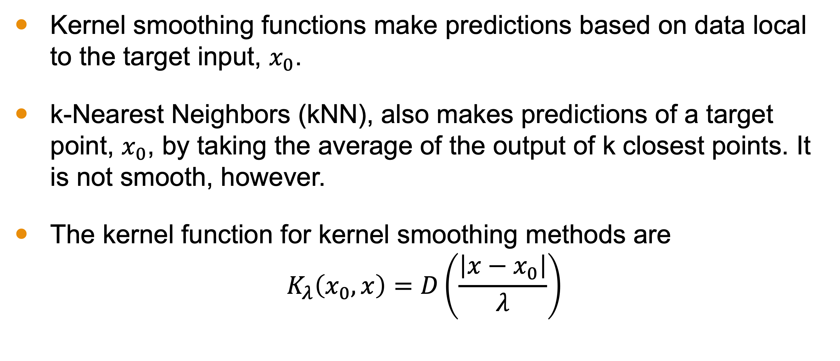
Conclusion
Kernel smoothing functions make predictions based on data local to the target input, $x_{0}$.
k-Nearest Neighbors (kNN), also makes predictions of a target point, $x_{0}$, by taking the average of the output of k closest points. It is not smooth, however.
The kernel function for kernel smoothing methods are $K_{λ}\left(x_{0}, x\right)=D\left(\frac{\left|x−x_{0}\right|}{λ}\right)$

